Slide 1

Presentation and Update to the Ohio Criminal Sentencing Commission
Harvey J. Reed, Director
Linda S. Janes, Assistant Director

Slide 2
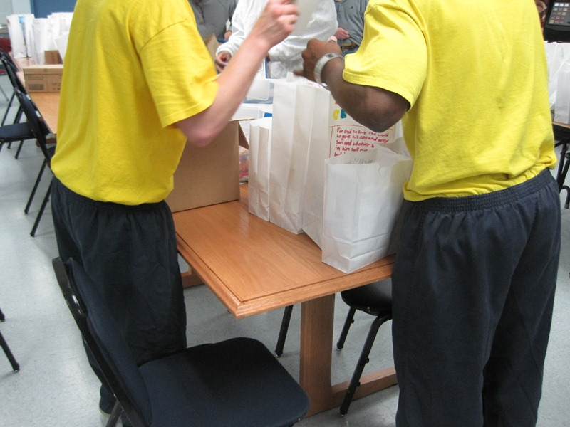
Mission and Vision
Mission: To improve Ohio’s future by habilitating youth and empowering families and communities
Vision: A safer Ohio: one youth, one family and one community at a time

Slide 3
Reaching Youth in Ohio
3 Juvenile Correctional Facilities
5 alternative placement options
5 Regional Parole Offices
12 Community Corrections Facilities
DYS funds and supports 600 community programs throughout the state serving 80,000 youth (based on annual program admissions)

Slide 4
Budget Overview

Slide 5
DYS Population
DYS
  June 2000: 2,183 youth
  June 2007: 1,848 youth
  June 2014: 501 youth
Parole
  June 2000: 2,013 youth
  June 2007: 1,446 youth
  June 2014: 372 youth

Slide 6
Total DYS Admissions
CY 2007 to CY 2013

Slide 7
Youth Adjudicated for Felonies
FY 2007 to 2013
47.6% decrease
FY 07 to FY 13
28.8% reduction in adjudications over the past 3 years

Slide 8
Juvenile Transfers to Adult Court
FY 2007 to 2013
10 year average = 277; 10 year high = 362; 10 year low =163

Slide 9
Admissions by County

Slide 10
Admissions by Race
7.1%
60.5%

Slide 11
Admissions by Gender
92.7%

Slide 12
Admissions by Age
Age at Admission (FY 14)

Slide 13
Admissions by Offenses

Slide 14
Services for Victims
January 2015
  Youth with opted-in victims: 511
  Youth impact statements on file: 140
  Victim apology letters on file: 393

Slide 15
Serious Youthful Offenders (SYOs)
Youth classified as “SYOs” have cases that remain in juvenile court but are subject to a blended juvenile-adult sentence if found delinquent
DYS takes the issue of requesting the invocation of the adult portion of the sentence seriously
Because an adult sentence is involved, these youth must be indicted by a grand jury, and they are entitled to a jury trial

Slide 16
SYO Statistics

Slide 17
SYO Statistics

Slide 18
Mandatory Sentences
ORC 2152.17
2941.141 Firearm on or about offender’s person or under control specification
2941.142 Criminal gang participation specification
2941.144 Automatic firearm or firearm muffler or silencer specification
2941.145 Firearm displayed, brandished, indicated that offender possessed the firearm or used it to facilitate offense specification
2941.146 Firearm discharged from motor vehicle specification
2941.1412 Discharged firearm at peace officer or corrections officer specification
2941.1414 Peace officer victim of aggravated vehicular homicide specification
2941.1415 Multiple OVI violations specification

Slide 19
Mandatory Sentences
As of 1-7-15, DYS had a total of 163 youth that had a mandatory sentence (35% of the population) – nearly all are for firearm specifications
  133 youth - 2941.145 Firearm displayed, brandished, indicated that offender possessed the firearm or used it to facilitate offense specification
  22 youth - 2941.141 Firearm on or about offender’s person or under control specification
  8 youth fall into the other categories

Slide 20
Early Releases
522 releases in 2014
  Judicial release to parole: 95
  Judicial release to probation: 37
    TOTAL: 132 youth (25.3% of all youth released from DYS)

Slide 21

Challenges and Strategies
Challenge | Strategy
Diverse needs | Individualizing services for youth
Violence | Path to Safer Facilities
Gangs | Community Model Approach to Gangs
Idleness | Quality structured programming
Separation | Family engagement and volunteers

Slide 22
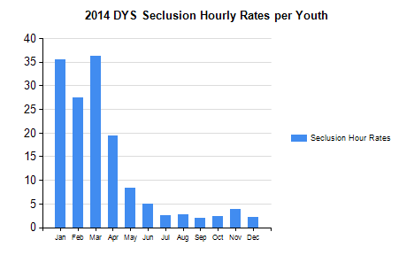
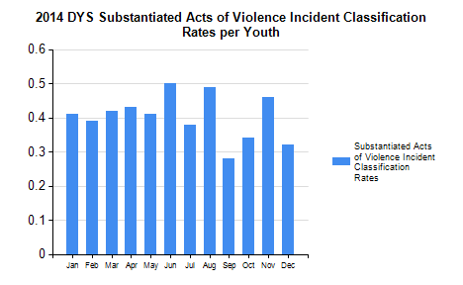
Moving Away from Using Seclusion as a Punishment

Slide 23
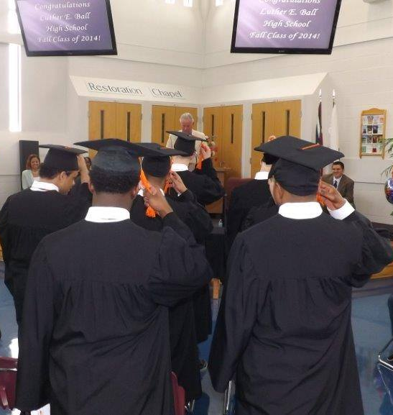
Buckeye United School District
Fiscal Year 2014
  Served 727 students
  86 youth received GEDs
  26 youth obtained high school diplomas
  Awarded 346 career certificates were awarded
Nearly half of all student receive special education services
Apprenticeships

Slide 24

Questions?

