Slide 1
Supreme Court of Ohio
Ohio Judicial Center
Artwork

Slide 2
North
Reflecting Pool

Slide 3
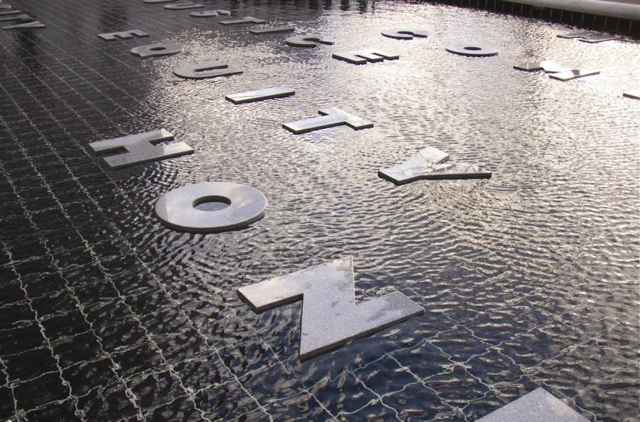
MALCOLM COCHRAN
American, b. 1948
In Principle and In Practice
2006
Granite
Funded by a grant from the
Ohio State Bar Foundation

Slide 4
South
Reflecting Pool

Slide 5
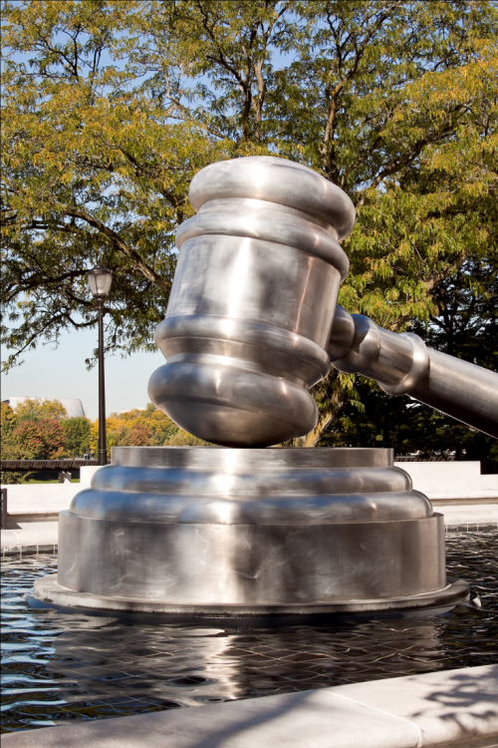
ANDREW SCOTT
American, b. 1964
Gavel
2008
Stainless Steel
Funded by a grant from the
Ohio State Bar Foundation

Slide 6
Civic Center
Drive Lobby

Slide 7
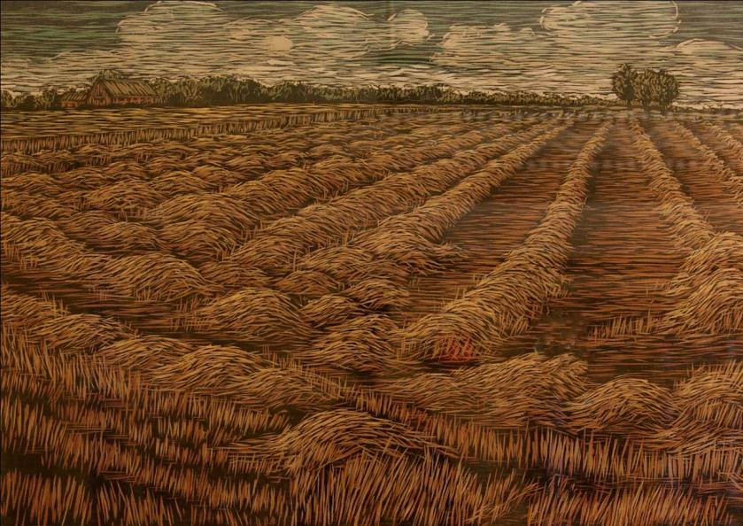
KIM VITO
Born 1964
Straw Field
2004
Woodcut on paper
(35.25 x 28.25 with frame)
Collection of the Supreme Court of Ohio

Slide 8
First
Floor

Slide 9
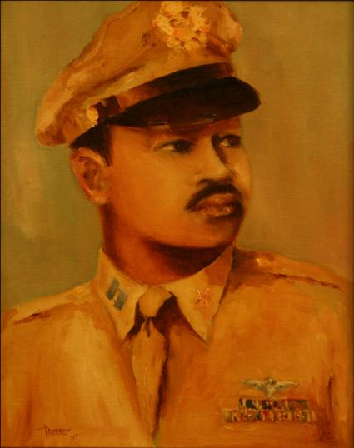
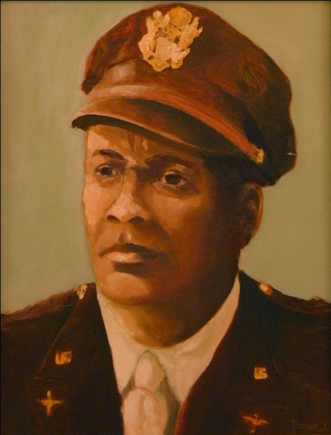
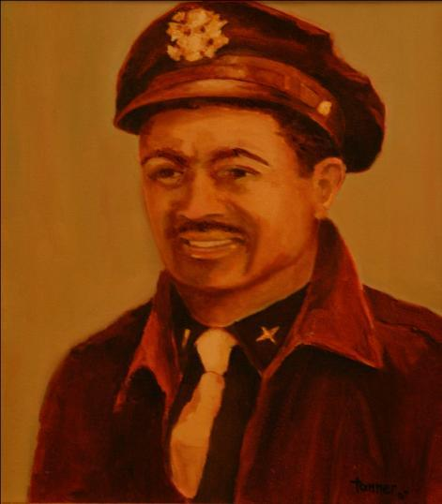
Robert E. Tanner, Sr.
Tuskegee Airmen Series
Born 1933
2007
Oil on canvas
Louis R. Purnell
(17.5 x 20.5 with frame)
Daniel “Chappie” James, Jr.
(17.5 x 20.5 with frame)
Harry T. Stewart, Jr.
(17.5 x 20.5 with frame)
Artist’s gift to the Supreme Court of Ohio

Slide 10
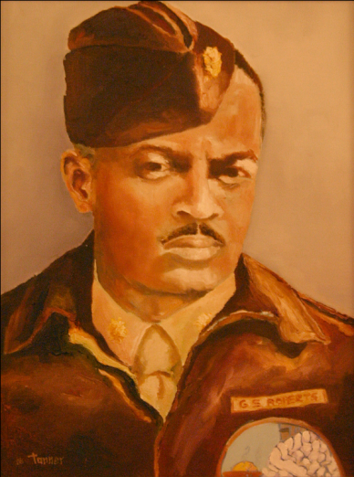
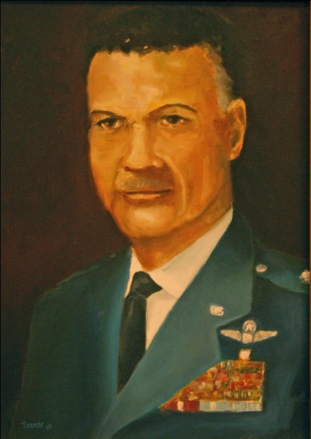
Robert E. Tanner, Sr.
Tuskegee Airmen Series
Born 1933
2007
Oil on canvas
George S. “Spanky” Roberts
(18.5 x 22.5 with frame)
Benjamin O. Davis, Jr.
(18.5 x 22.5 with frame)
Artist’s gift to the Supreme Court of Ohio

Slide 11
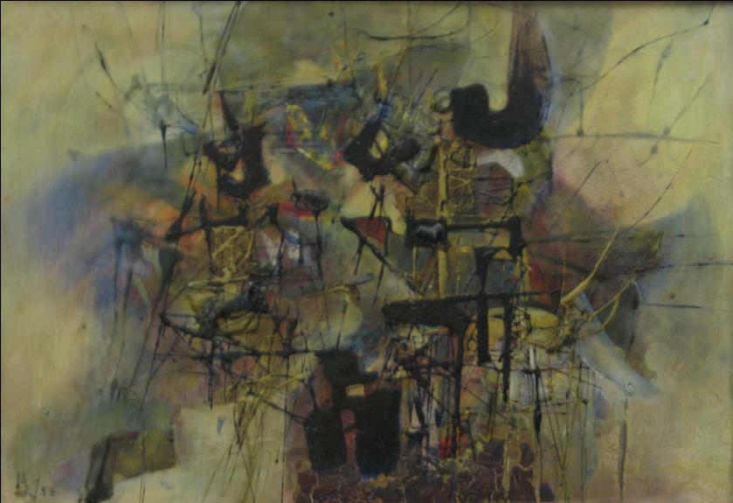
Murray Jones
American, 1915 - 1964
#8
1958
Automotive lacquer and Japanese paper collage on masonite
Gift of Molly Jones
1992.011.002
On loan from the Columbus Museum of Art: Gift of Molly Jones

Slide 12
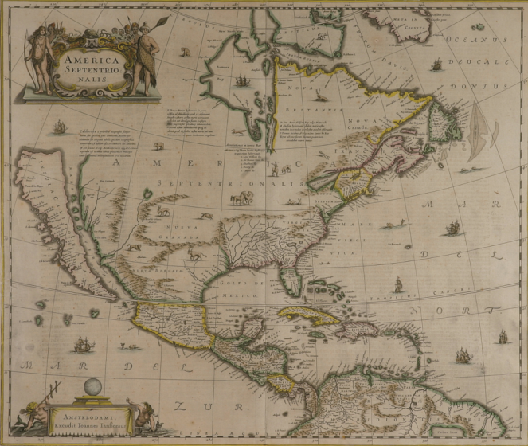
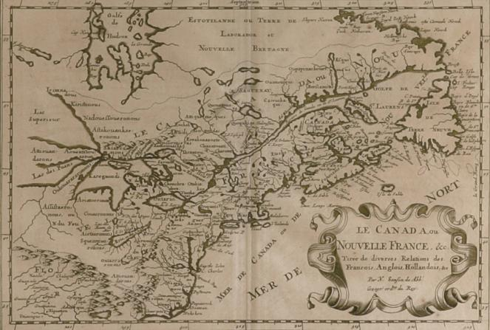
Kingsley A. Taft
Map Room (16 maps)
Le Canada, ou Nouvelle France
America Septentrionalis

Slide 13
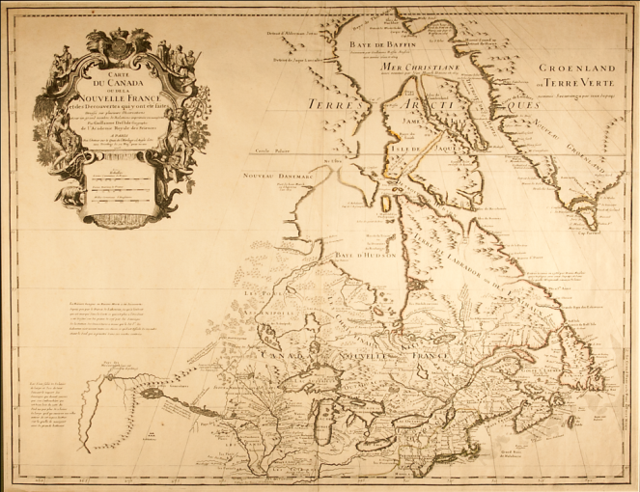
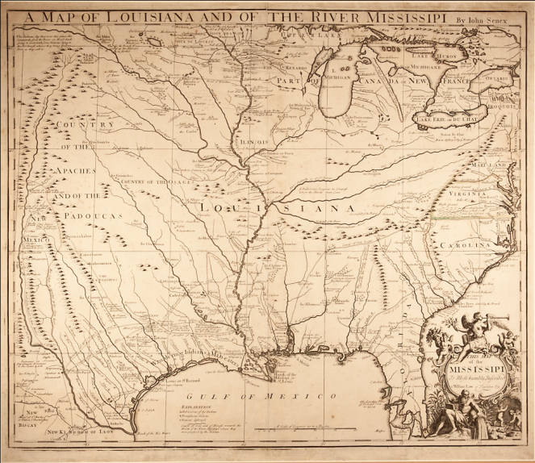
Taft Maps
Carte du Canada ou de la Nouvelle France
et des Decouvertes qui y ont été faites
A Map of Louisiana and of the River Mississipi

Slide 14
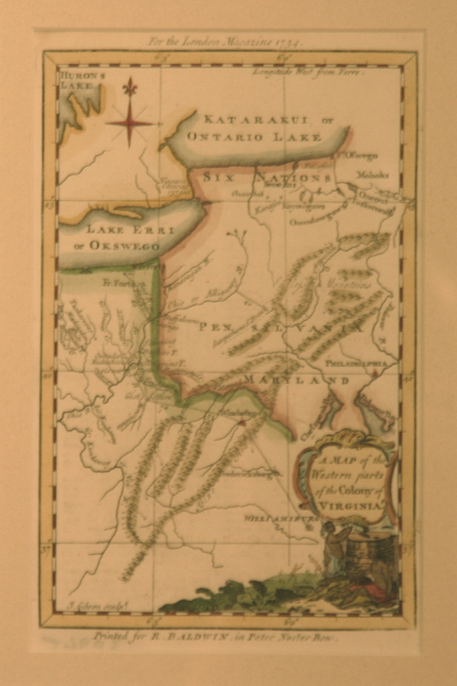
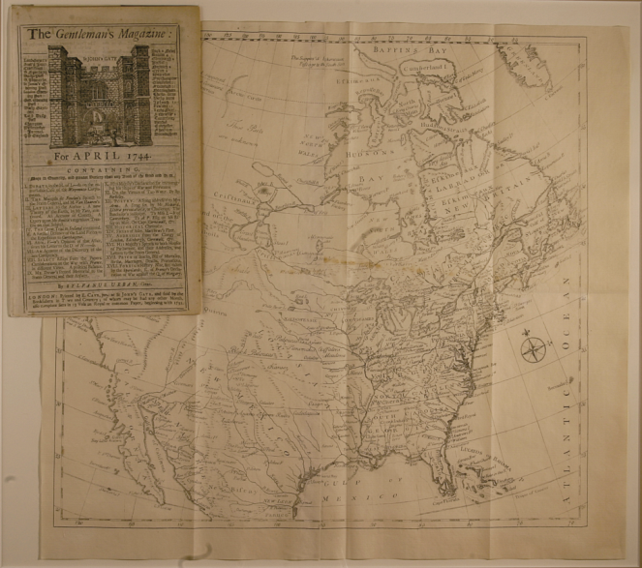
Taft Maps
The Gentleman’s Magazine
Map of North America
A Map of the Western parts
of the Colony of Virginia

Slide 15
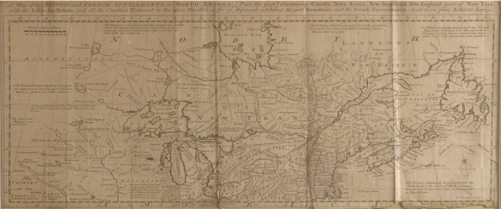
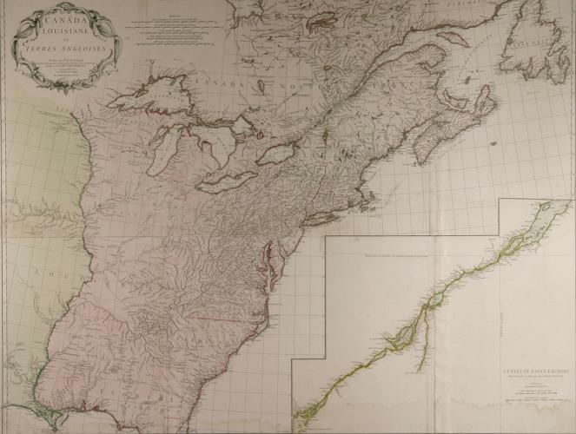
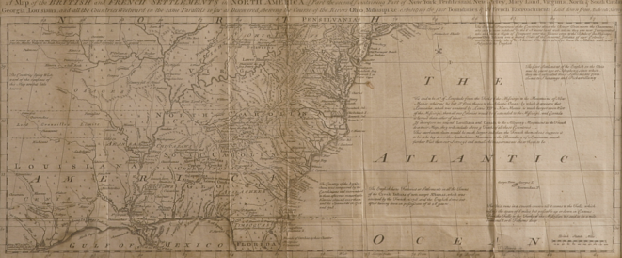
Taft Maps
Canada Louisiane et Terres Angloises
A Map of the British and French Settlements in
North America, exhibiting the just Boundaries
and the French Encroachments

Slide 16
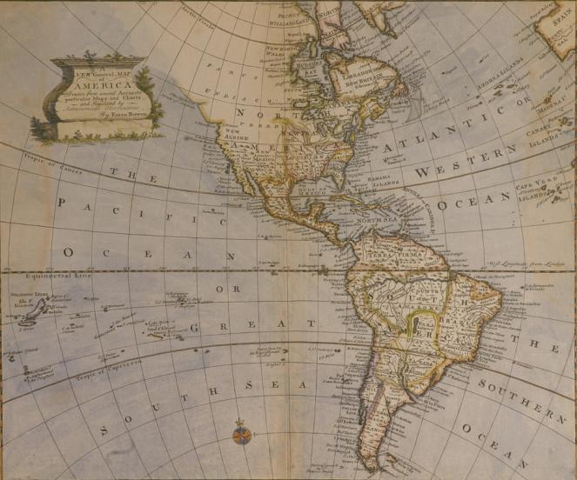
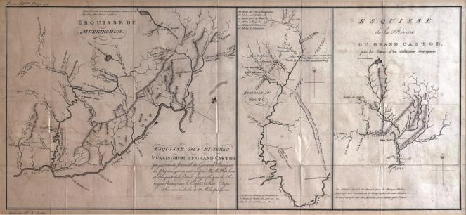
Taft Maps
Esquisse des Rivieres Muskingum,
Esquisse du Sioto &
Esquisse de la Riviere du Grand Castor
A New General Map of America

Slide 17
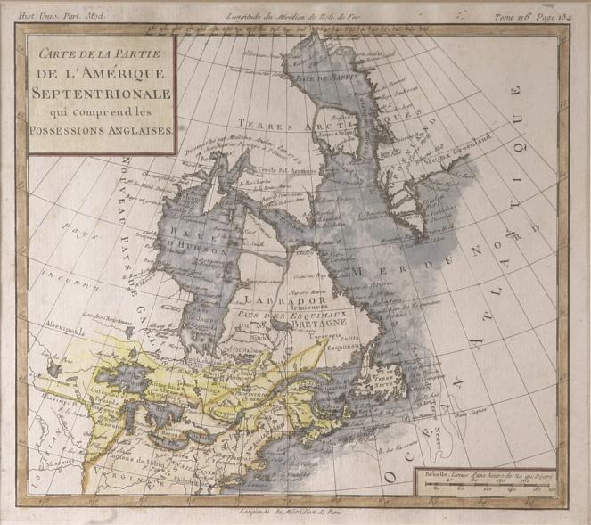
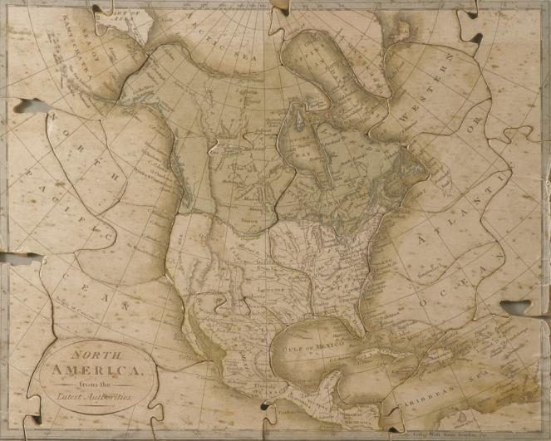
Taft Maps
North America, from the Latest Authorities
Carte de la Partie de l’Amérique
Septentrionale qui comprend les
Possessions Anglaises

Slide 18
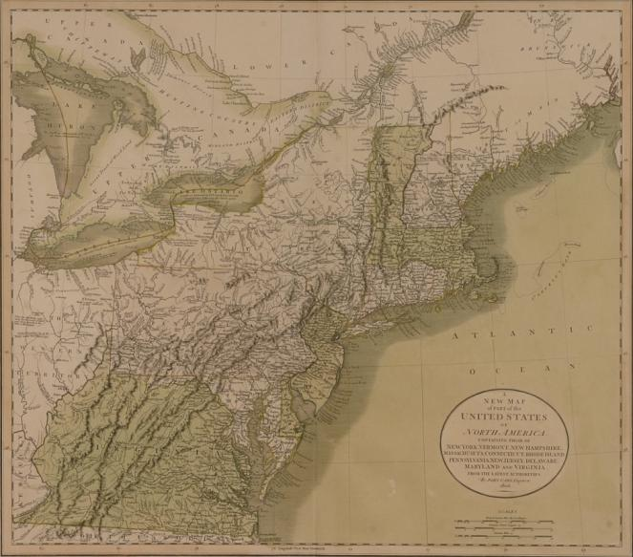
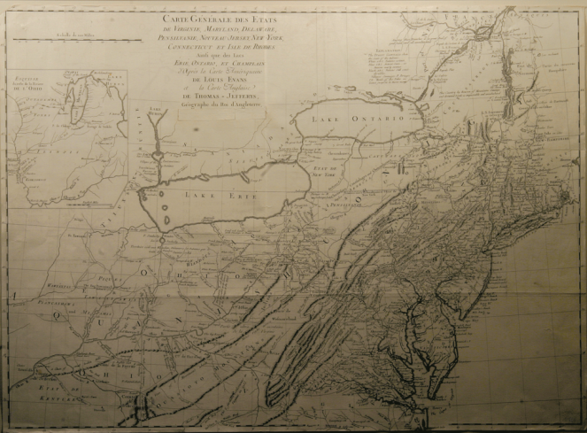
Taft Maps
Carte Générale des Etats de Virginie, Maryland, Delaware, Pensilvanie, Nouveau-Jersey, New-York, Connecticut et Isle de Rhodes
A New Map of Part of the United States of North America

Slide 19
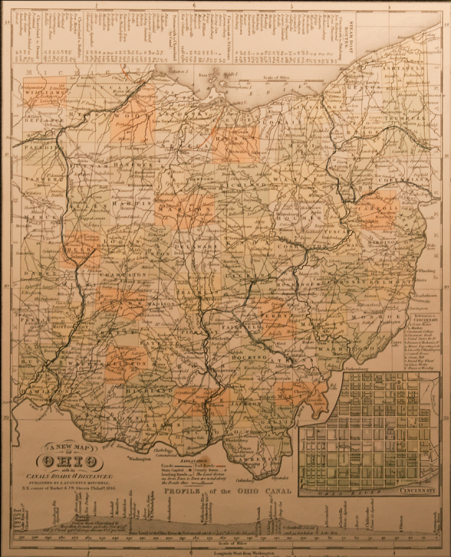
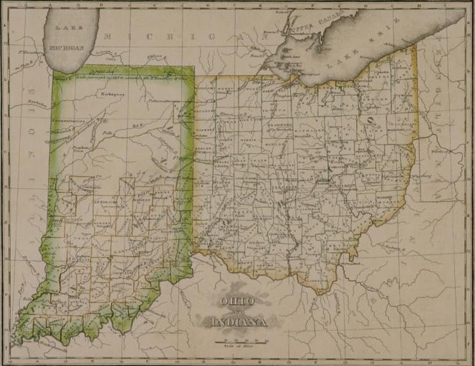
Taft Maps
Ohio and Indiana
A New Map of Ohio

Slide 20
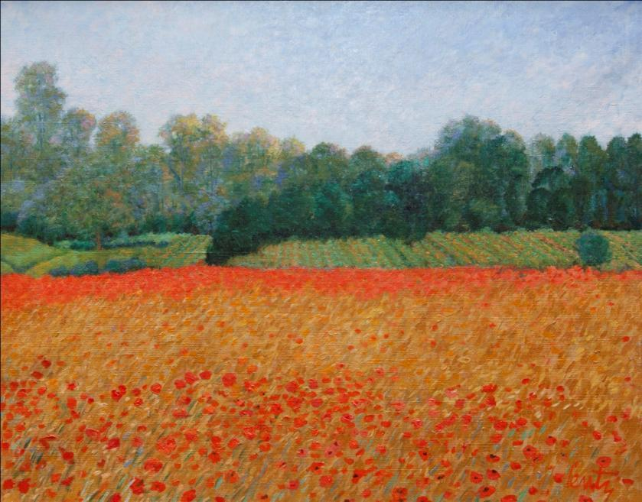
JANCE LENTZ
Born 1941
Poppies Near Le Lude
2007
Oil on canvas
(16 x 20)
Collection of the Supreme Court of Ohio

Slide 21
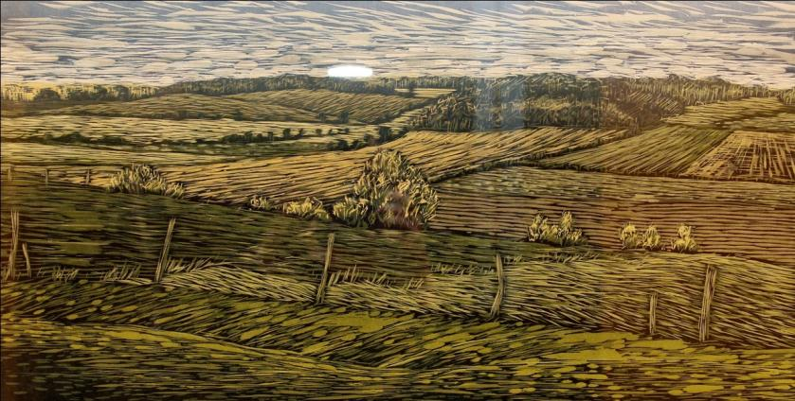
KIM VITO
Born 1964
Smucker Field
2004
Woodcut on paper
(36 x 24 with frame)
Collection of the Supreme Court of Ohio

Slide 22
Second
Floor

Slide 23
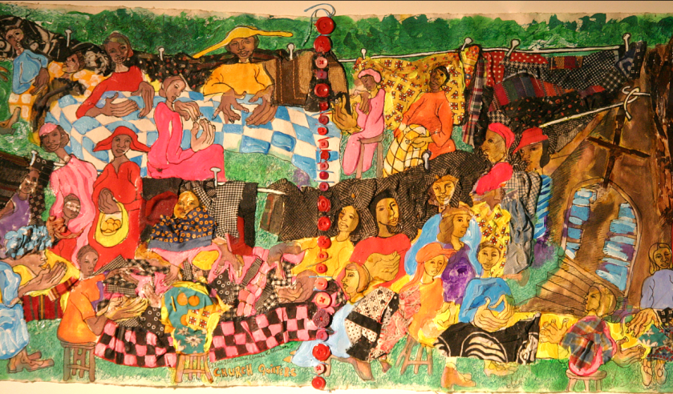
AMINAH BRENDA LYNN ROBINSON
Born 1940
From Along Water Street series
Church Quilters on Water Street
2000-2007
Rag painting: cloth, buttons, thread, pen and ink, pencil and paint on paper
(18 x 45)
Collection of the Supreme Court of Ohio

Slide 24
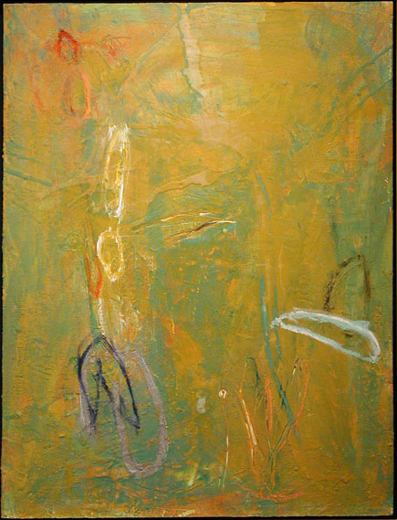
DENNISON GRIFFITH
Born 1952
Near Southbeach
2003
Encaustic and oil on panel
(56 x 44)
Collection of the Supreme Court of Ohio

Slide 25
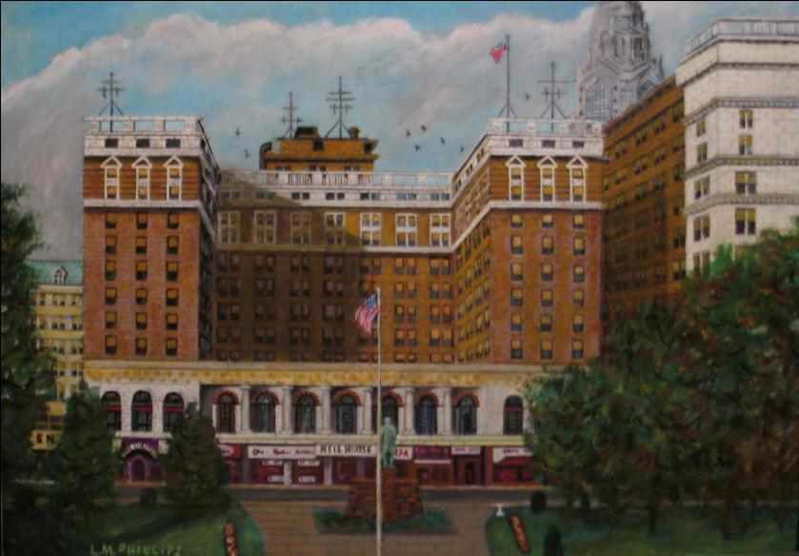
Reverend L. M. Phillips
American, 1900 - 1991
Neil House
1989
Oil on canvas
Gift of Dave and Joann Phillips and Lindsay Gallery
2005.016
On loan from the Columbus Museum of Art: Gift of Dave and Joanne Phillips and Lindsay Gallery

Slide 26
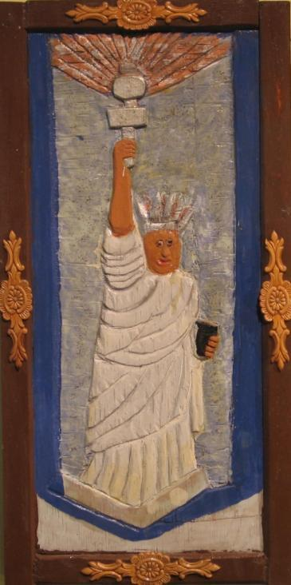
Elijah Pierce
American, 1892 - 1984
The Statue of Liberty
1973
Painted wood relief
On loan from the Columbus Museum of Art: Museum Purchase
1985.003.087

Slide 27
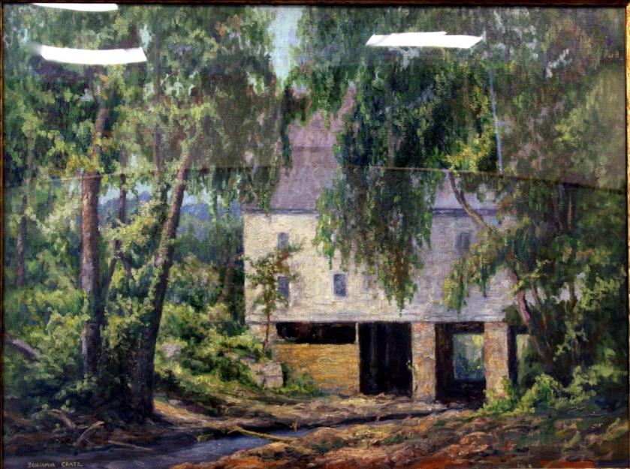
BENJAMIN A. CRATZ
1886-1951
The Old Mill, Zoar
c. 1905-1910
Oil on canvas
On loan from the Ohio Historical Society

Slide 28
Fourth
Floor

Slide 29
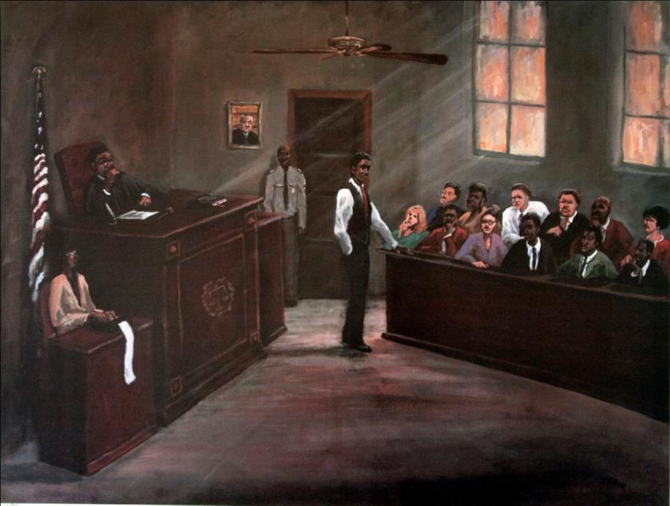
TED ELLIS
Born 1963
Justice
1993
Print 420/950
(39.5 x 32.25 with frame)
Gift of Donna A. and Larry H. James
Collection of the Supreme Court of Ohio

Slide 30
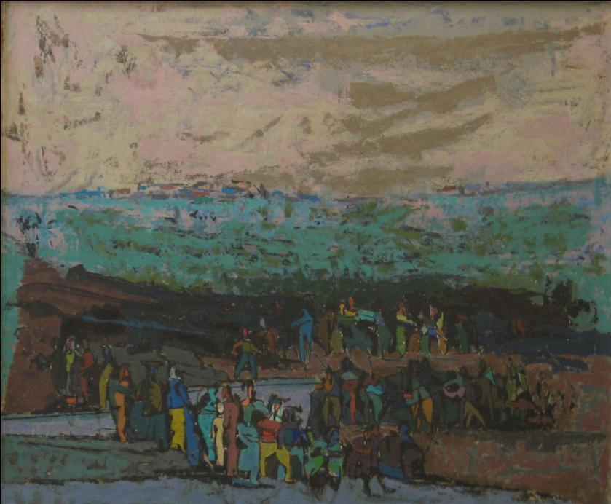
Charles Csuri
American, born 1922
Wanderers
c. 1942 – 1957
Oil on canvas
Howald Fund Purchase
1957.031
On loan from the Columbus Museum of Art: Howald Fund Purchase

Slide 31
Fifth
Floor

Slide 32
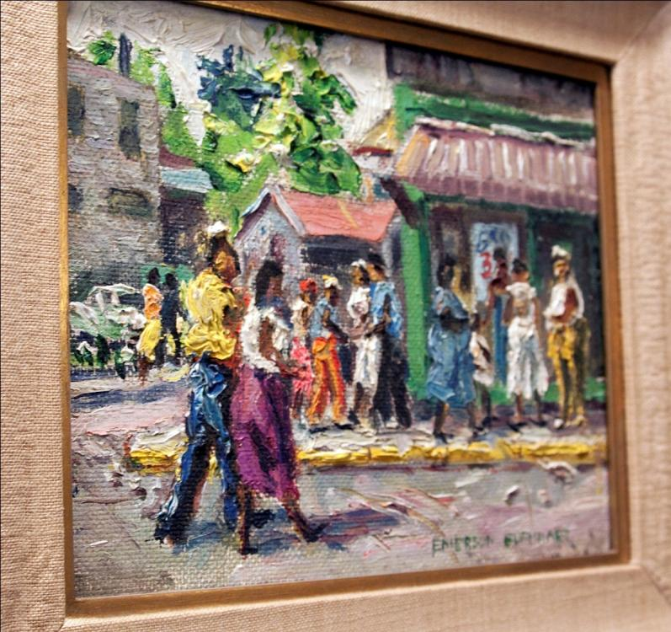
JEAN KOELLER
Born 1958
Untitled
2007
Oil on canvas
(13.5 x 13.5)
Collection of the Supreme Court of Ohio

Slide 33
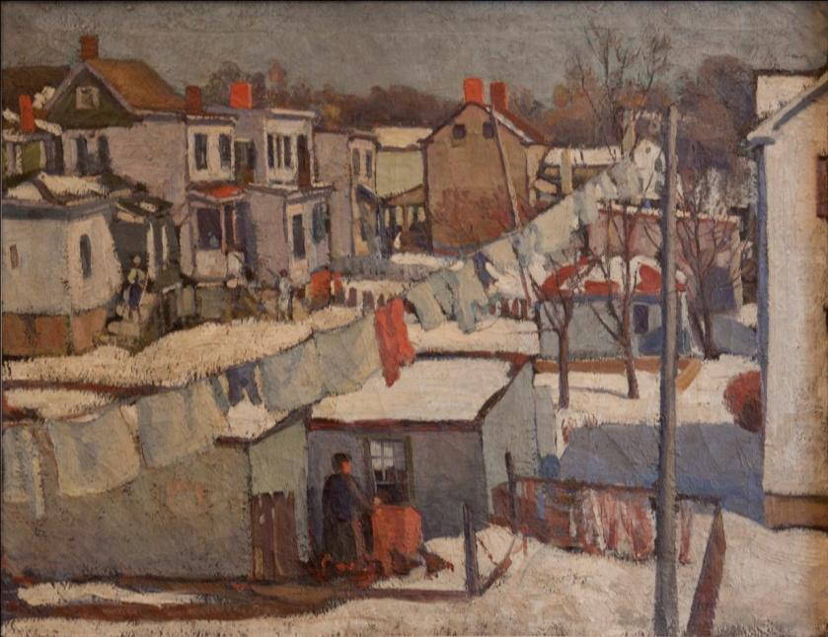
Robert O. Chadeayne
1987 – 1981
Winter Wash
1921
Oil on canvas
On loan from the Columbus Museum of Art: Howald Fund Purchase

Slide 34
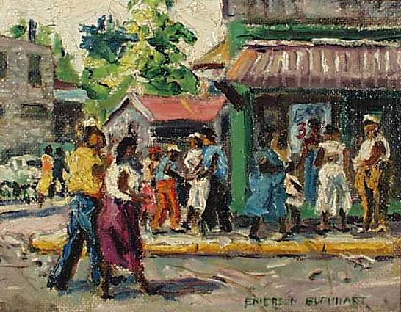
Emerson C. Burkhart
1905 – 1969
Eastside Columbus
1951
Oil on panel
On loan from the Columbus Museum of Art: Gift of Daniel Arnold, M.D.

Slide 35
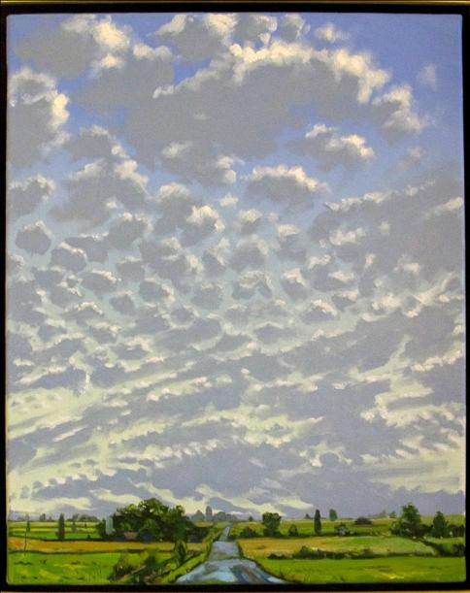
EDWARD CHARNEY
Born 1957
North River Road, 2008
2008
Oil on canvas
(16 x 20)
Collection of the Supreme Court of Ohio

Slide 36
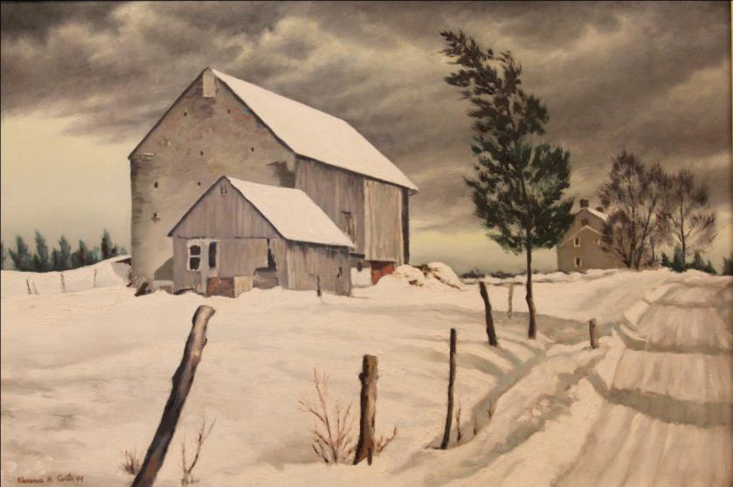
CLARENCE HOLBROOK CARTER
1904-2000
Dark Hollow Road
1949
Oil on panel
On loan from the Southern Ohio Museum:
Gift of Dorothy W. Miller in memory of James B. Miller

Slide 37
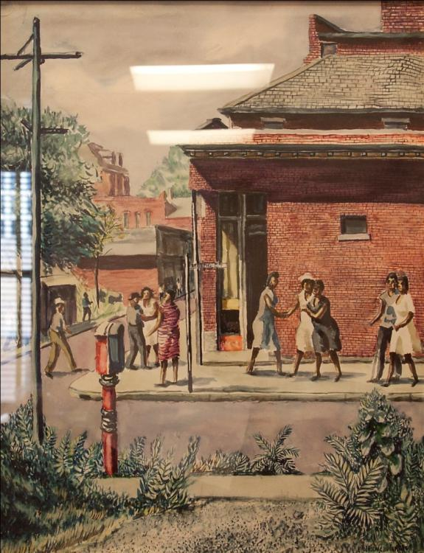
EMERSON C. BURKHART
1905-1969
Mound Street
c. 1944
Watercolor on paper
On loan from the Ohio Historical Society

Slide 38
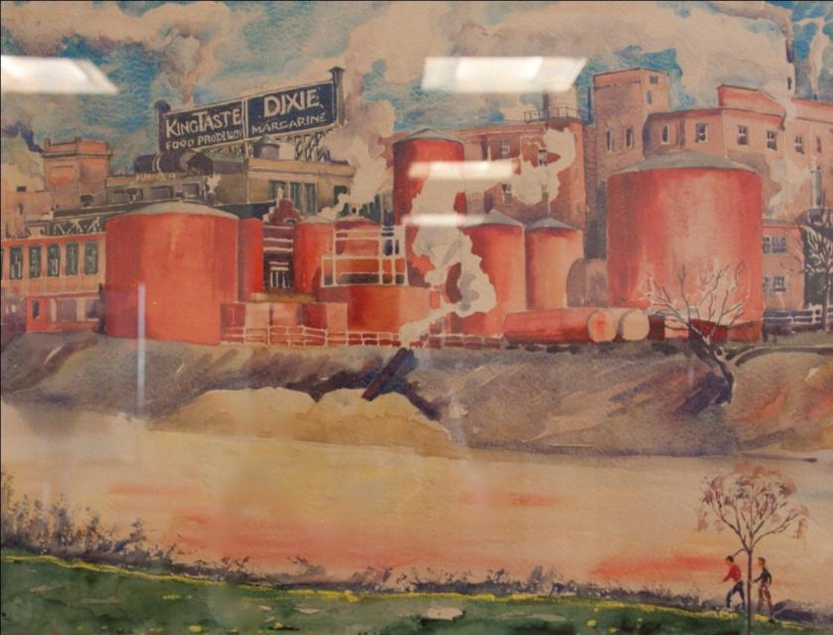
RALPH FANNING
1889-1971
Factories on the Olentangy River
c. 1940-1950
Watercolor on paper
On loan from the Ohio Historical Society

Slide 39
Sixth
Floor

Slide 40
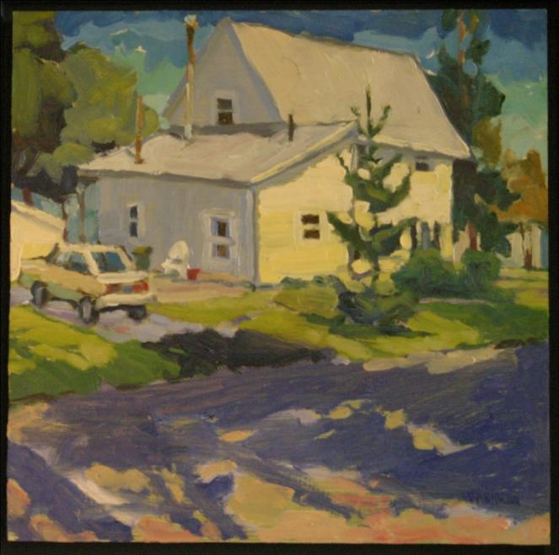
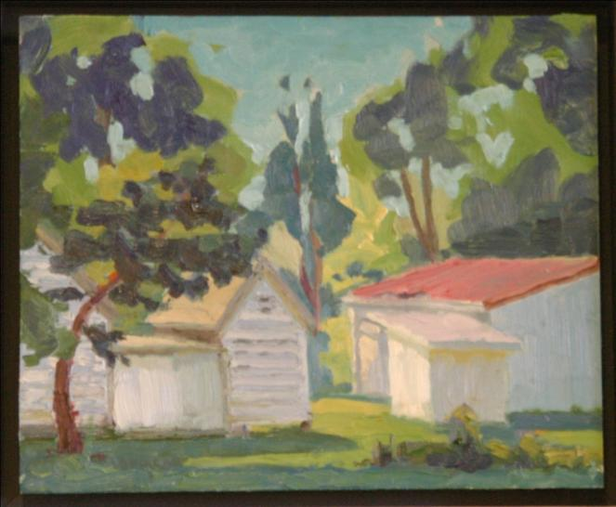
JOE LOMBARDO
Born 1983
2007
Oil on panel
Collection of the Supreme Court of Ohio
Behind the Barn
(8 x 12)
White Car
(12 x 12)

Slide 41
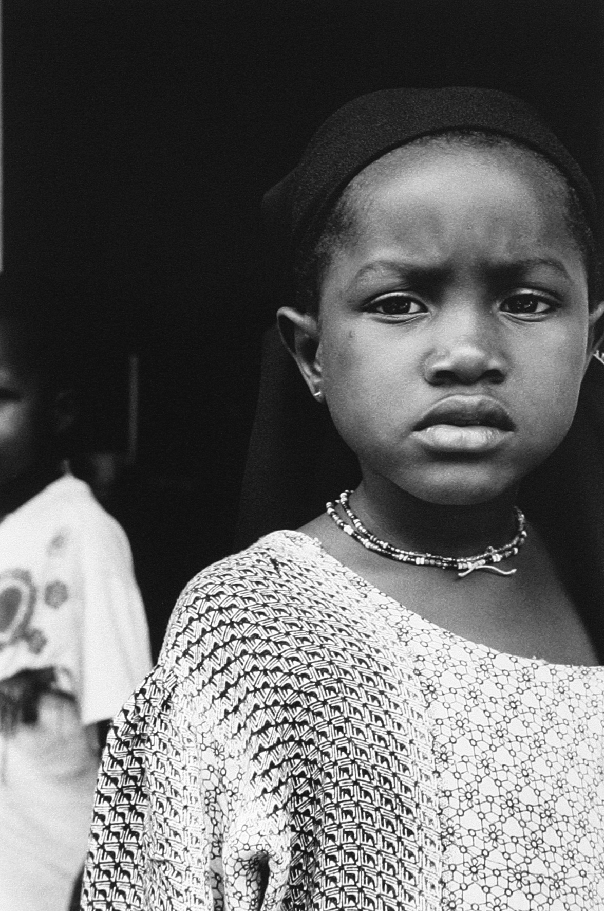
ABDI ROBLE
Born 1964
Batula
2004
Black and white photograph
(27.5 x 21.5 with frame)
Collection of the Supreme Court of Ohio

Slide 42
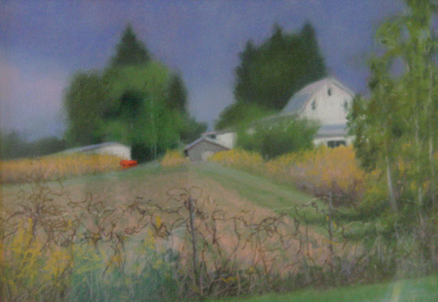
M. KATHERINE HURLEY
Born 1952
Red Hay Wagon
2006
Pastel
(14 x 21)
Collection of the Supreme Court of Ohio

Slide 43
Seventh
Floor

Slide 44
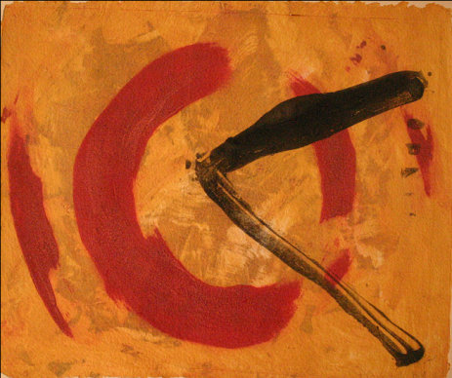
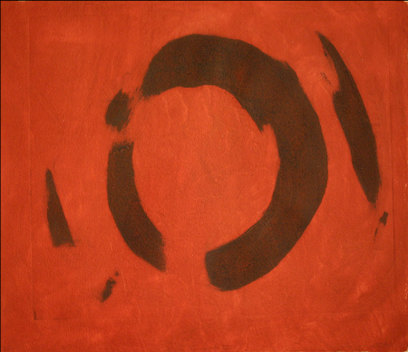
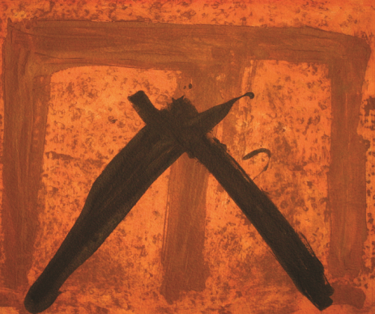
NICHOLAS HILL
American, b 1952
Carborundum aquatints
Posa, 2006
(24.75 x 30.25 with frame)
Campiello II, 2006
(27 x 34.5 with frame)
Oriel, 2006
(24.75 x 30.5 with frame)

Slide 45
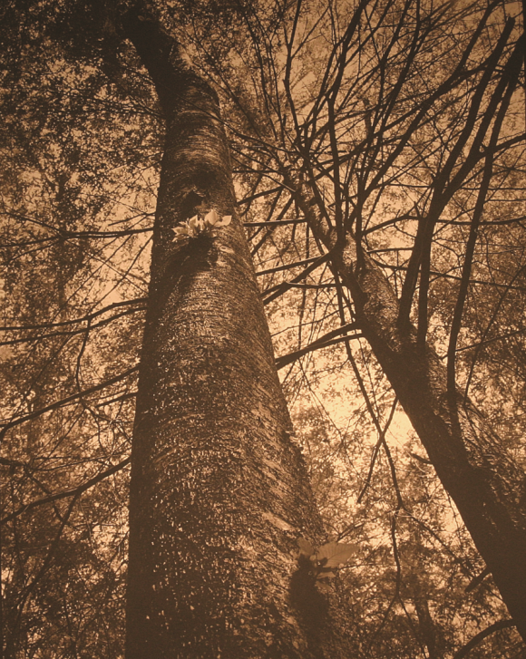

FRANK HUNTER
Born 1947
Platinum palladium print
Collection of the Supreme Court of Ohio
Beech Trees, Cedar Falls
2001 (25 x 29.5 with frame)
Beech Tree, Looking Up
2001 (25 x 29.5 with frame)

Slide 46


FRANK HUNTER
Born 1947
Platinum palladium print
Collection of the Supreme Court of Ohio
Beech Tree, Ash Cave
1994 (25 x 29.5 with frame)
Light along a Stream II, Hocking Hills
1997 (25 x 29.5 with frame)

Slide 47

CLARENCE HOLBROOK CARTER
1904-2000
Around the Bend
1952
Oil on panel
On loan from the Southern Ohio Museum:
Gift of the family of the late Richard H. and Helen Fenton

Slide 48

PAUL EMORY
Born 1958
Ohio Corn
2006
Oil on canvas
(36 x 30)
Collection of the Supreme Court of Ohio

Slide 49

KOJO KAMAU
Born 1939
Elijah Pierce
1974
Black and white photograph
(21 x 25 with frame)
Collection of the Supreme Court of Ohio

Slide 50

PAUL HAMILTON
Born 1965
Neighborly Respect
2007
Oil on canvas
(32.5 x 38.5)
Collection of the Supreme Court of Ohio

Slide 51

REBECCA TAFT
Born 1934
Parrots and Darwins
2007
Watercolor
(18 x 22)
Collection of the Supreme Court of Ohio

Slide 52
Eighth
Floor

Slide 53


DEBRA DAWSON
Born 1950
Oil on panel
Collection of the Supreme Court of Ohio
Marblehead Ohio Wetlands
2005 (8 x 10)
Misty Morn, Wooster, Ohio
2006 (10 x 8)

Slide 54

TOM HARBRECHT
Born 1953
View of Mt. Logan from Adena
2003
Oil on canvas
On loan from the Ohio Historical Society

Slide 55
Ninth
Floor

Slide 56

DIANE POWELL
Born 1948
Winter Night
1974
Drawing and ink
(9 x 13)
Gift of Sheldon A. Taft
Collection of the Supreme Court of Ohio

Slide 57

Silas Martin
1841 – 1906
Still Life with Apples
No date
Oil on masonite
On loan from the Columbus Museum of Art: Gift of Orlando A. Miller

Slide 58

Robert O. Chadeayne
American, 1897 - 1981
Barnyard
1931
Oil on canvas
On loan from the Columbus Museum of Art: Columbus Art League Purchase Award
1931.283

Slide 59
Tenth
Floor

Slide 60


Katherine Kadish
Born 1939
Oil and wax monotype
Collection of the Supreme Court of Ohio
April Series 72B
April Series 72A

Slide 61

RICHARD REED
Born 1940
Kent Reed and the Milk Cow
1985
Oil on panel
(26.25 x 20.25)
Collection of the Supreme Court of Ohio

Slide 62
Eleventh
Floor

Slide 63

Ron Anderson
Born 1951
From The History of the Rule of Law series
Signing of the Constitution
2005
Oil on canvas
Permanent loan from the Ohio State Bar Association

Slide 64

Ron Anderson
Born 1951
From The History of the Rule of Law series
Dethroning the Monarchy
2005
Oil on canvas
Permanent loan from the Ohio State Bar Association

Slide 65

Ron Anderson
Born 1951
From The History of the Rule of Law series
Draco, Coder of Law, and The Twelve Tables of Roman Law
2005
Oil on canvas
Permanent loan from the Ohio State Bar Association

Slide 66

Ron Anderson
Born 1951
From The History of the Rule of Law series
The Code of Hammurabi and The Rule of Ramses the Great
2005
Oil on canvas
Permanent loan from the Ohio State Bar Association

Slide 67

Ron Anderson
Born 1951
From The History of the Rule of Law series
Lady Justice Leading the People
2005
Oil on canvas
Permanent loan from the Ohio State Bar Association

Slide 68

Ron Anderson
Born 1951
From The History of the Rule of Law series
The Signing of the Magna Carta
2005
Oil on canvas
Permanent loan from the Ohio State Bar Association

Slide 69

Dale Chihuly with Lino Tagliapietra and Ben Moore
Seattle, Washington
Gilded Coral Red Ikebana with Prism
2002
Blown glass
Permanent loan from the
Ohio State Bar Association

Slide 70

Dale Chihuly with Lino Tagliapietra and Ben Moore
Seattle, Washington
Mottled Citron Green Ikebana with Blue and Teal Flowers
2002
Blown glass
Permanent loan from the
Ohio State Bar Association

